Slide 1
Presentations

Slide 2
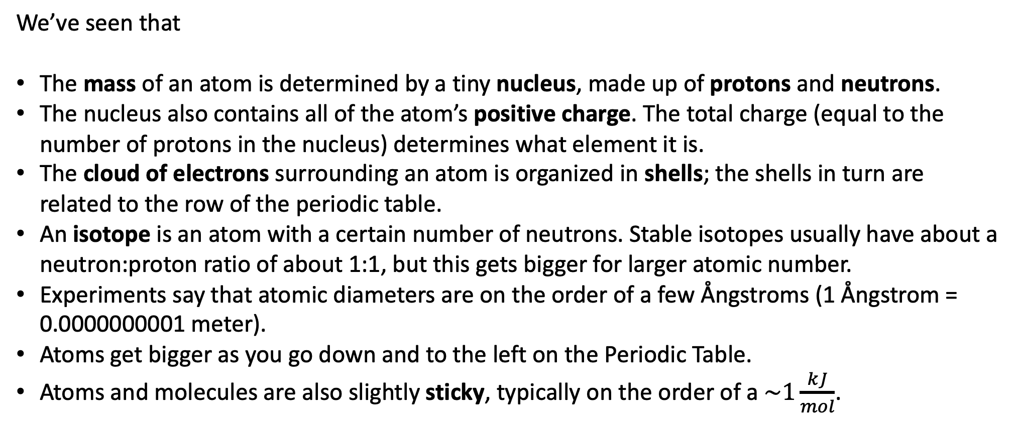
Atomic structure summary
We’ve seen that
The mass of an atom is determined by a tiny nucleus, made up of protons and neutrons.
The nucleus also contains all of the atom’s positive charge. The total charge (equal to the number of protons in the nucleus) determines what element it is.
The cloud of electrons surrounding an atom is organized in shells; the shells in turn are related to the row of the periodic table.
An isotope is an atom with a certain number of neutrons. Stable isotopes usually have about a neutron:proton ratio of about 1:1, but this gets bigger for larger atomic number.
Experiments say that atomic diameters are on the order of a few Ångstroms (1 Ångstrom = 0.0000000001 meter).
Atoms get bigger as you go down and to the left on the Periodic Table.
Atoms and molecules are also slightly sticky, typically on the order of a $\sim 1\frac{kJ}{mol}$.

Slide 3
Text preview: Atomic Structure
The PhET simulator had you constructing atoms with various isotopes
The text shows the same ideas with images like this:

Slide 4
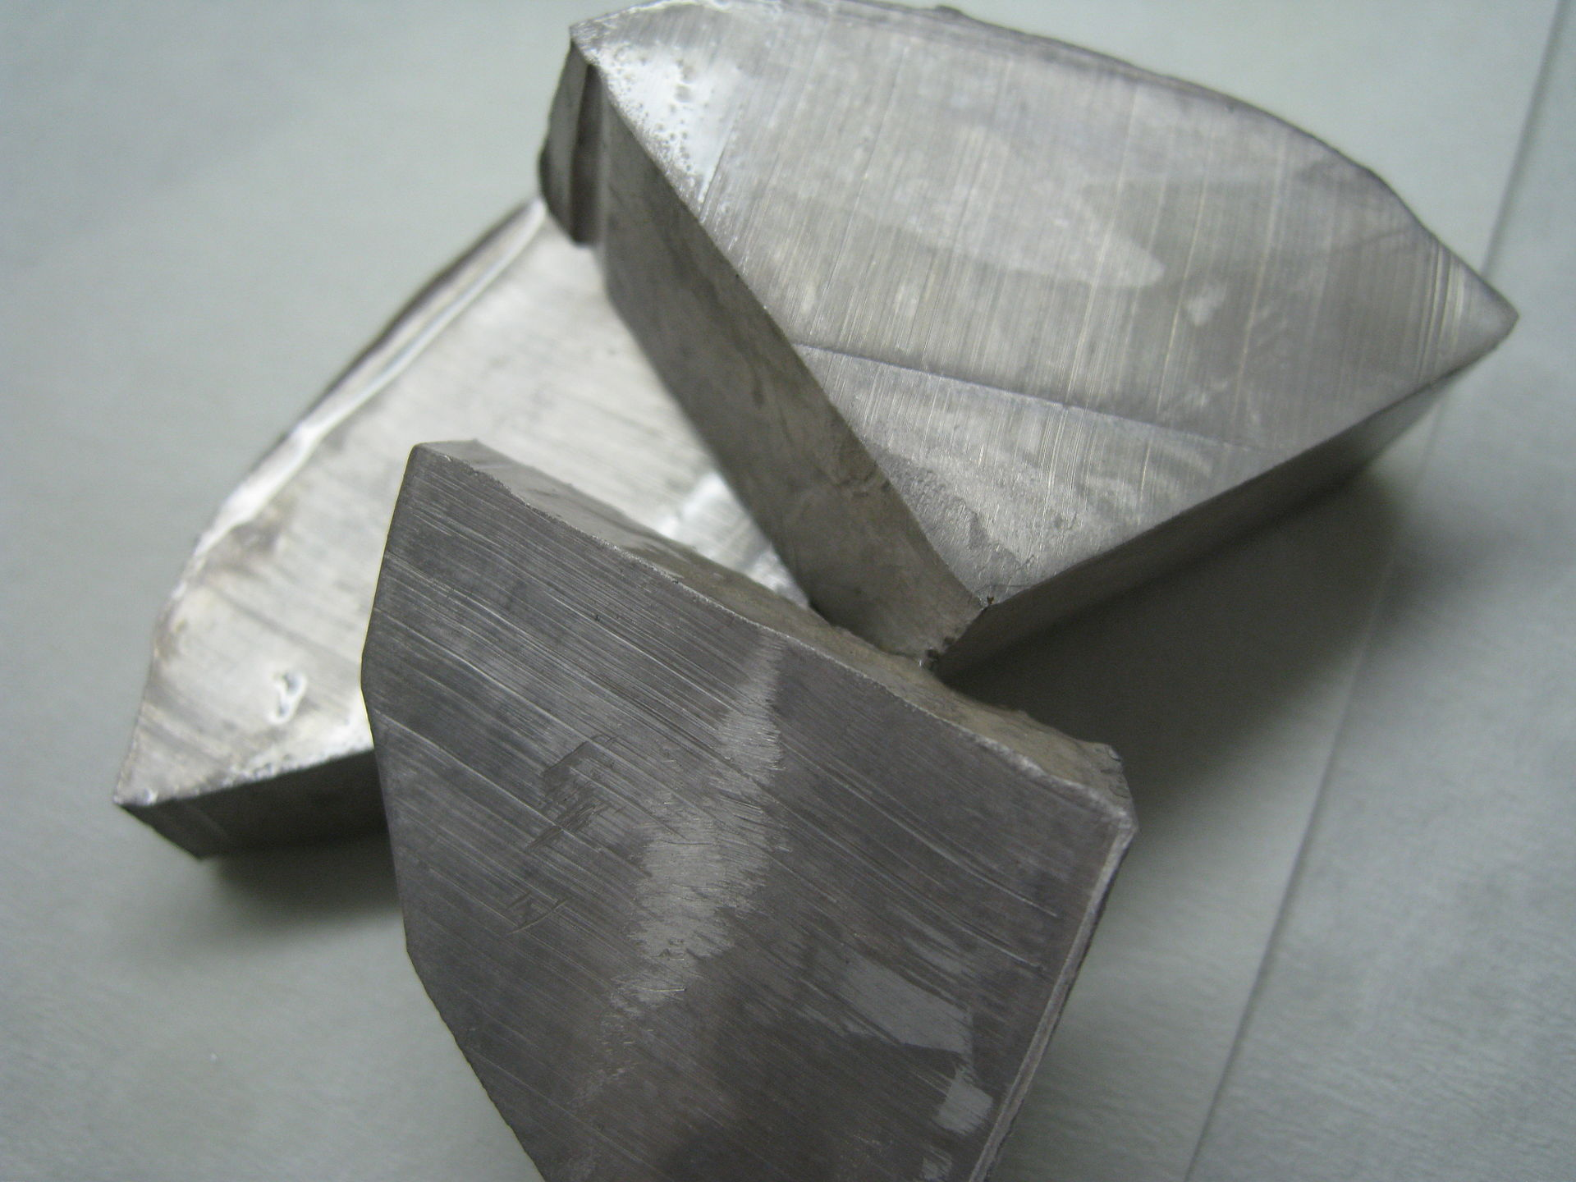
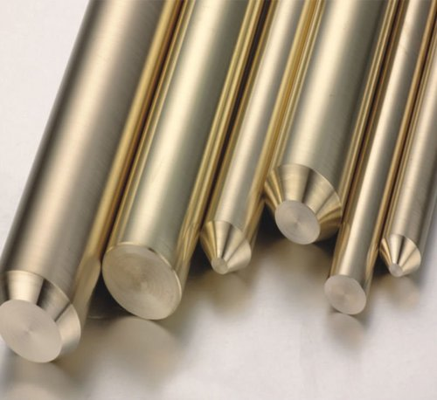
Text preview: Metals combine to form metal mixtures (also called alloys)
Elemental sodium (Na)
Bronze: a mixture of copper (Cu) and tin (Sn)

Slide 5
Text preview: Nonmetals combine to form covalent molecules
When nonmetals combine with other nonmetals the result is called a covalent molecule
Carbon dioxide
CO₂
Methane
CH₄
Water
H₂O

Slide 6
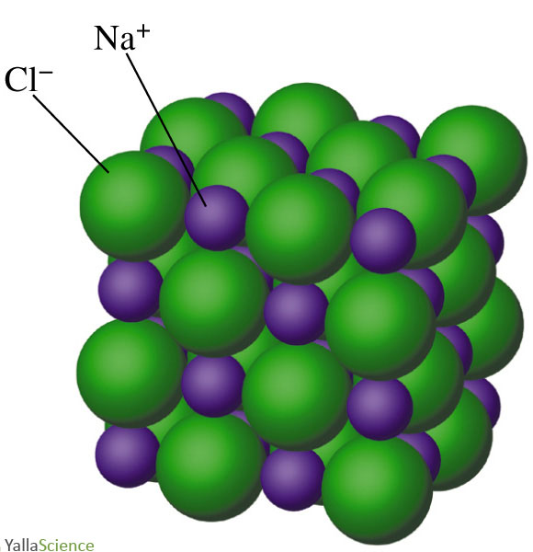
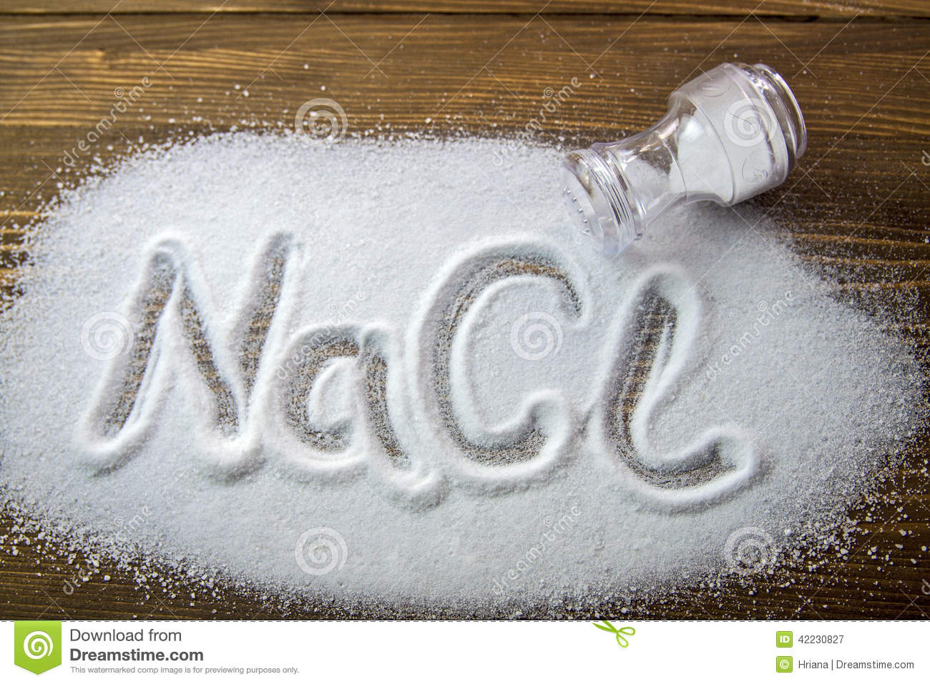
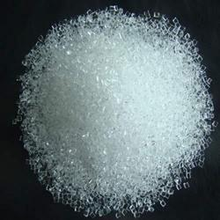
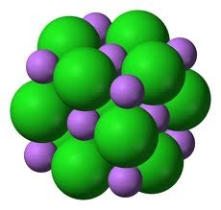
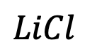
Text preview: Nonmetals combine with metals to form salts
When a nonmetal combines with a metal you get an ionic compound (a.k.a. salt)
$LiCl$

Slide 7
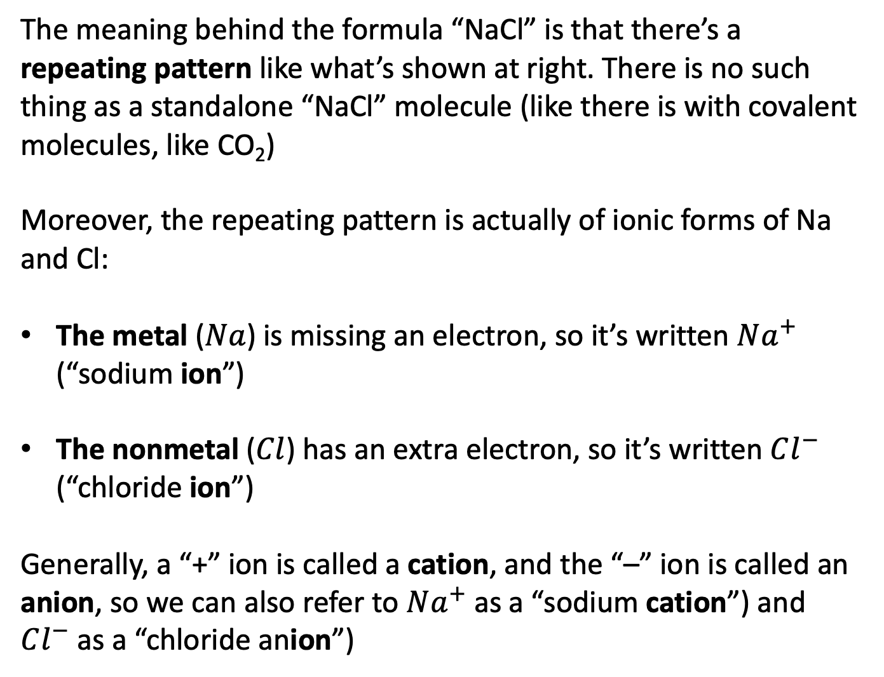
Text preview: The chemical formula of a salt tells you the repeating pattern of ions
The meaning behind the formula “NaCl” is that there’s a repeating pattern like what’s shown at right. There is no such thing as a standalone “NaCl” molecule (like there is with covalent molecules, like CO₂)
Moreover, the repeating pattern is actually of ionic forms of Na and Cl:
The metal ($Na$) is missing an electron, so it’s written $Na^{+}$ (“sodium ion”)
The nonmetal ($Cl$) has an extra electron, so it’s written $Cl^{−}$ (“chloride ion”)
Generally, a “+” ion is called a cation, and the “–” ion is called an anion, so we can also refer to $Na^{+}$ as a “sodium cation”) and $Cl^{−}$ as a “chloride anion”)

Slide 8
Text preview: Physical classifications of matter
These are pretty intuitive, except plasmas, which are found on the sun (really hot)

Slide 9

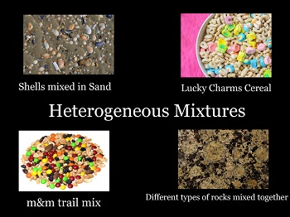
Text preview: Physical classifications of matter
Bronze and green stuff
Heterogeneous mixtures are mixtures whose components you can distinguish visually

Slide 10
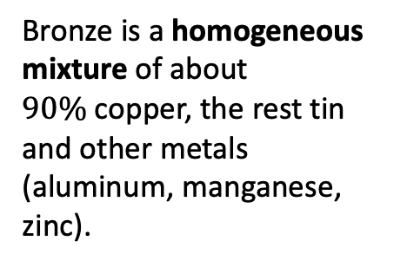
Text preview: Physical classifications of matter
Bronze is a homogeneous mixture of about $90\%$copper, the rest tin and other metals (aluminum, manganese, zinc).
Homogeneous mixtures look pure at the macroscopic level, but at the molecular level are made up of different types of atoms in proportions that that are not absolutely fixed

Slide 11
Text preview: Physical classifications of matter
Bronze is a homogeneous mixture of about $90\%$copper, the rest tin and other metals (aluminum, manganese, zinc).
We say homogeneous because we don’t see chunks of copper, tin, etc.
Homogeneous mixtures look pure at the macroscopic level, but at the molecular level are made up of different types of atoms in proportions that that are not absolutely fixed

Slide 12
Text preview: Physical classifications of matter
Bronze is a homogeneous mixture of about $90\%$copper, the rest tin and other metals (aluminum, manganese, zinc).
We say homogeneous because we don’t see chunks of copper, tin, etc.
We say a mixture because proportions are not fixed: the amount of copper can be higher or lower than 90%, etc.
Homogeneous mixtures look pure at the macroscopic level, but at the molecular level are made up of different types of atoms in proportions that that are not absolutely fixed

Slide 13
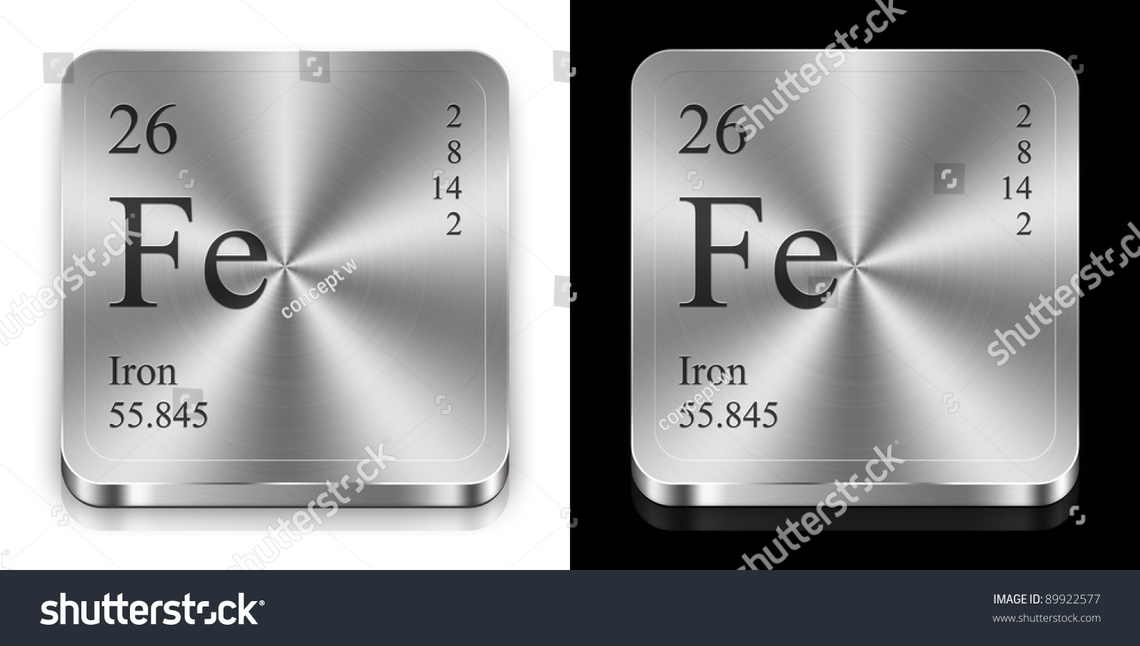
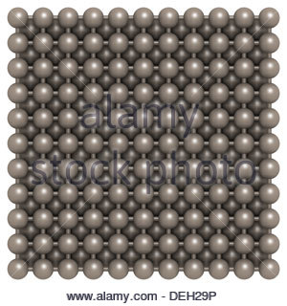
Text preview: Chemical classifications of matter
Na
Elemental sodium at the macroscopic level
Elemental iron at the macroscopic level
Elemental iron at the molecular level
Pure elements are substances that have only one type of atom

Slide 14

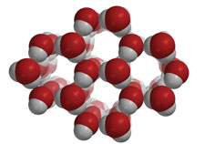
Text preview: Chemical classifications of matter
Water at the macroscopic level
At the molecular level, the proportion of oxygen to water is absolutely fixed (“H₂O”)
Molecular compounds look pure at the macroscopic level, but at the molecular level are made up of molecules with different atoms

Slide 15
Wrapping Week 1, prep for Week 2 (see Canvas pages)

